Slide 1


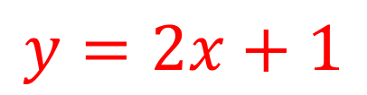
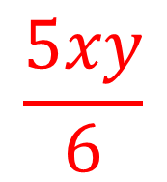
My Algebra Interactive Notebook
$$\frac{5xy}{6}$$
$$3ab$$
$$2x+3y$$
$$y=2x+1$$
Name
Class
Term 3 Semester 2

Slide 2
Contents
Page
Date
Description
2
3

Slide 3
Tasks
24
7
30
Essential Question
Questions
Notes
Summary
4
5

Slide 4
24
7
30
Date
EQ -
5

Slide 5
Fill in the questions

Slide 6
Notes Review
24, 7 ,30
Date
Title
Essential question
Notes complete
Notes complete with colour and diagrams
Questions completed
Contents page filed in
Formula page filled in

Slide 7
Homework
Review your notes and write a summary answering the essential question.

